Slide 1
Simple plots in R
David Jorgensen

Slide 2
R plot function
The most used plotting function in R is plot()
It can produce many types of plots depending on the data passed to the function

Slide 3
Simple case – plotting a vector
Make a vector c(1,1,2,3,4,5,6,2,1) and pass it to the plot function in R
What do you get?

Slide 4
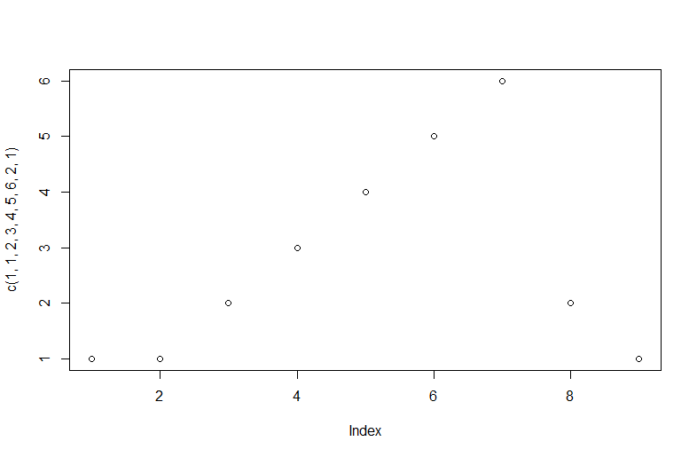
Should look like this:

Slide 5
Plotting 2 vectors:
Try plot(c(1,2,2,3,4), c(5,4,3,3,2))
You should get a plot of one vector against the other where the position of each number determines the number it is plotted against:

Slide 6
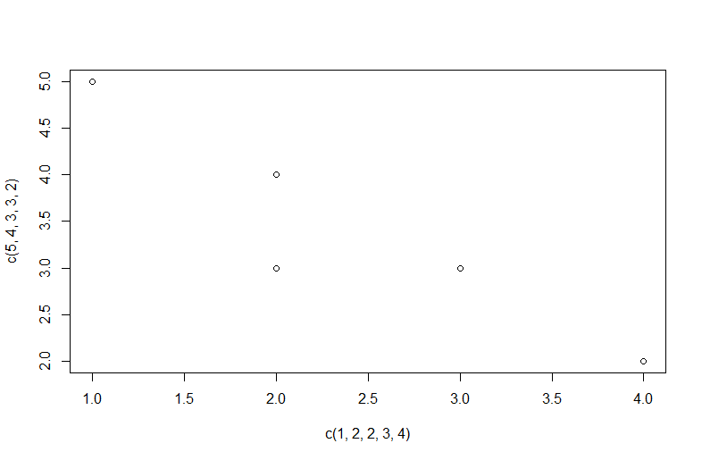

Slide 7
Creating some data to plot
We will use the seq() and sin() functions to create a sine curve between -3 and 3 which we can plot.
Create an object named x with a sequence from -3 to 3 with increments of 0.1

Slide 8
x <- seq(-3,3,0.1)
We will now plot a sine curve at these points using plot:
plot(x, sin(x))

Slide 9
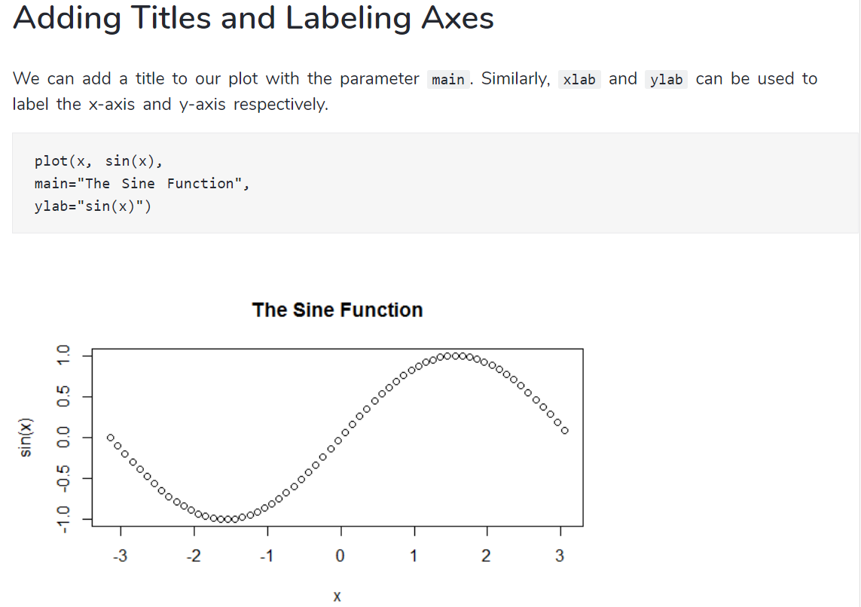

Slide 10
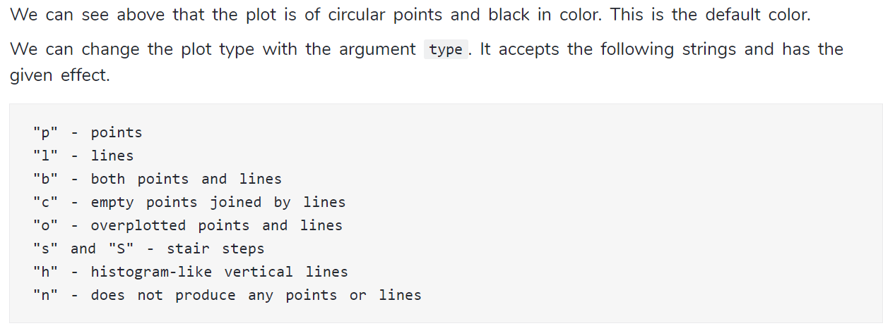
Changing plot type
Try changing your plot to a line:

Slide 11
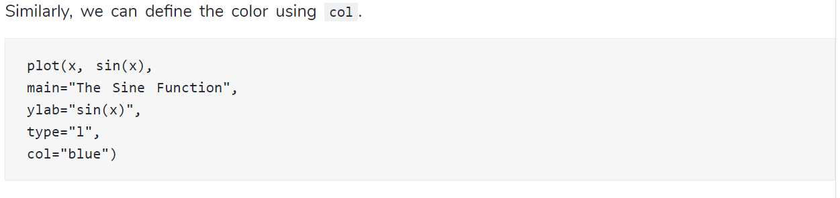
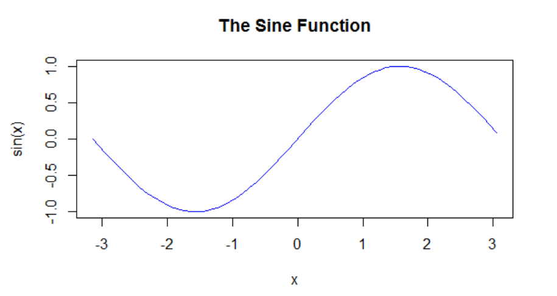

Slide 12
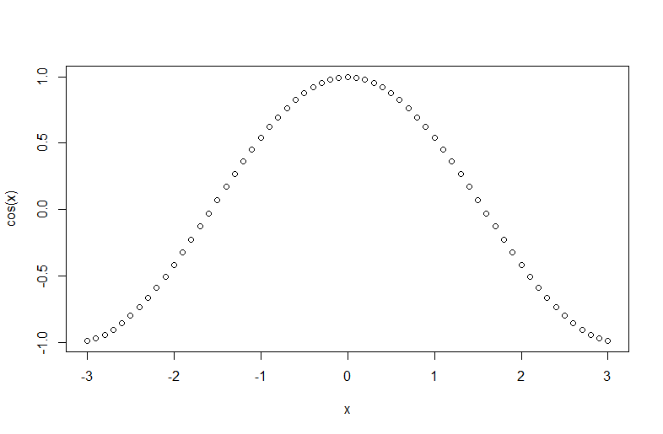
Plotting multiple lines
Calling plot multiple times will write over the current plot in the plots window:
plot(x, sin(x))
plot(x, cos(x))

Slide 13
Plotting multiple lines
We can use lines() rather than the plot function to add additional lines we want to plot to the graph:
We can use points in a similar way to plot points over an existing plot, try the above code with points() rather than lines()
plot(x, sin(x), main="Overlaying Graphs", ylab="", type="l", col="blue")
lines(x,cos(x), col="red")

Slide 14
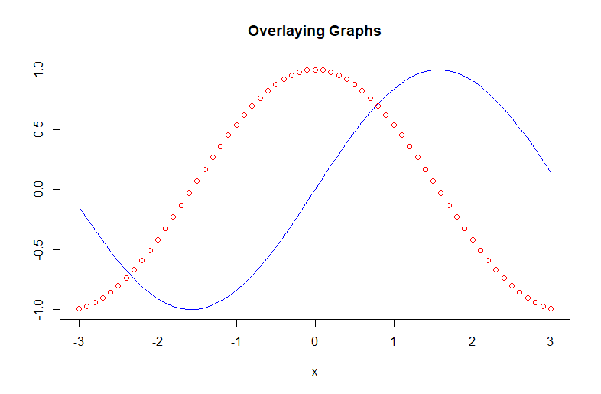

Slide 15
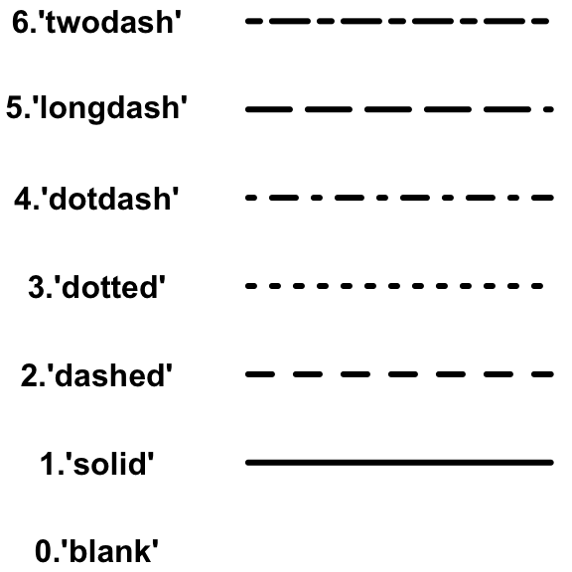
Changing the linetype
You can change the type of line plotted using the lty argument in lines or plot, try changing your added points to a line and plotting with a different linetype.

Slide 16
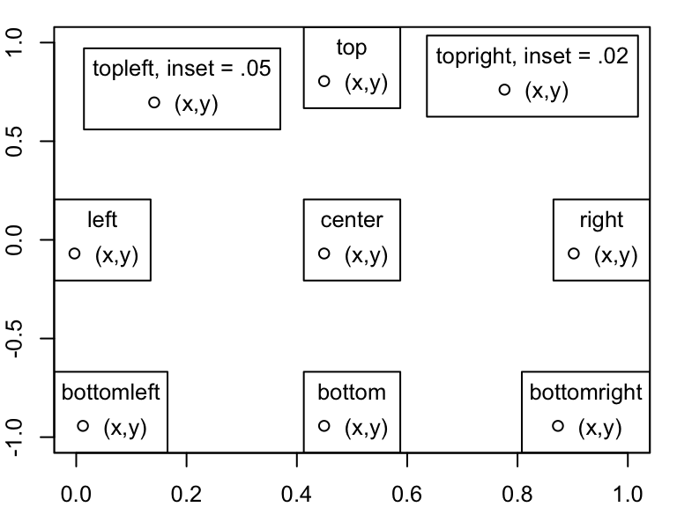
Add a legend to the plot
plot(x, sin(x), main="Overlaying Graphs", ylab="", type="l", col="blue")
lines(x,cos(x), col=“red”, lty=2)
legend(“topleft”, legend=c(“sin(x)”,“cos(x)”),
col=c(“blue”, “red”),
lty=c(1,2)

Slide 17
More plotting functions
We will use the mtcars sample dataset in R to try out some more plotting functions.
Run View(mtcars) to see the data in Rstudio

Slide 18
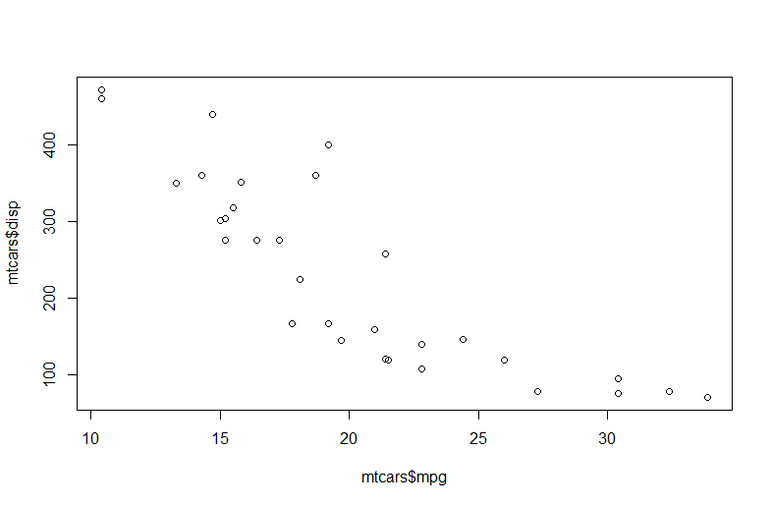
Changing point shape
Plot mtcars$mpg against mtcars$disp in R, it should look like this:

Slide 19
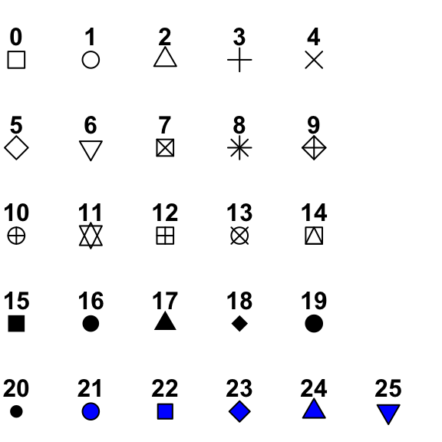
Changing point shape
we can change the shape of the points using the pch argument in the plot function, the point shapes are specified by numbers:
Try changing the shape of the points in your data

Slide 20
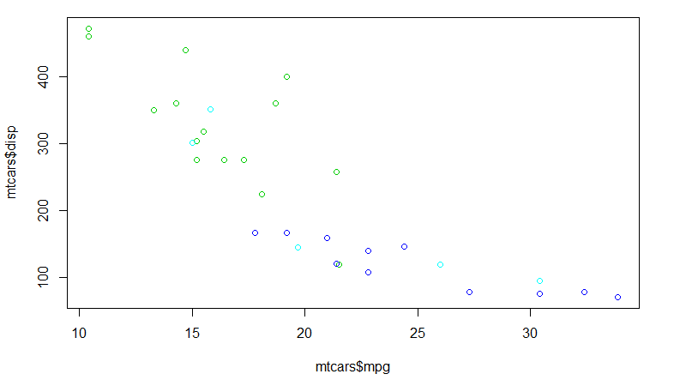
Colour by a factor
Using the col argument we can colour the points by other columns in our data, for example:
plot(mtcars$mpg, mtcars$disp, col=mtcars$gear)

Slide 21
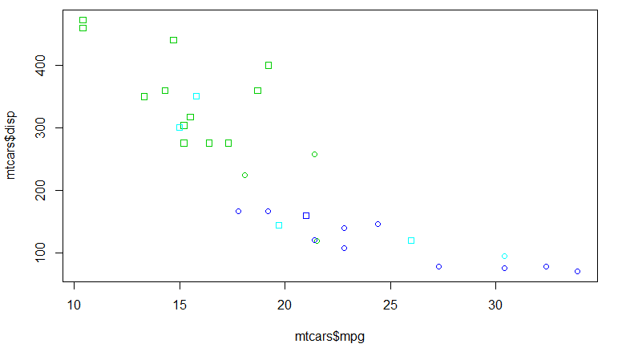
Shape by a factor
plot(mtcars$mpg, mtcars$disp, col=mtcars$gear)
Use the pch and col arguments to produce a plot coloured by gear with point shapes from vs:

Slide 22
Label the plot
Use xlab and ylab to label your axes miles per gallon and displacement

Slide 23
hist()
The hist function can be used to plot simple histograms of the frequency of a parameter in your dataset or a vector.
Choose a column in mtcars and plot it with the hist function
Hist automatically bins your data in to groups with similar values which are then summed in to a single bar. To change the number or position of these bins we can use the breaks argument in hist:
hist(mtcars$drat, breaks=10)
hist(mtcars$drat, breaks=c(min(mtcars$drat),4.0,4.5, 5.0, max(mtcars$drat))))
Try running this code in R, see how changing the values in the breaks argument changes the position of the break points

Slide 24
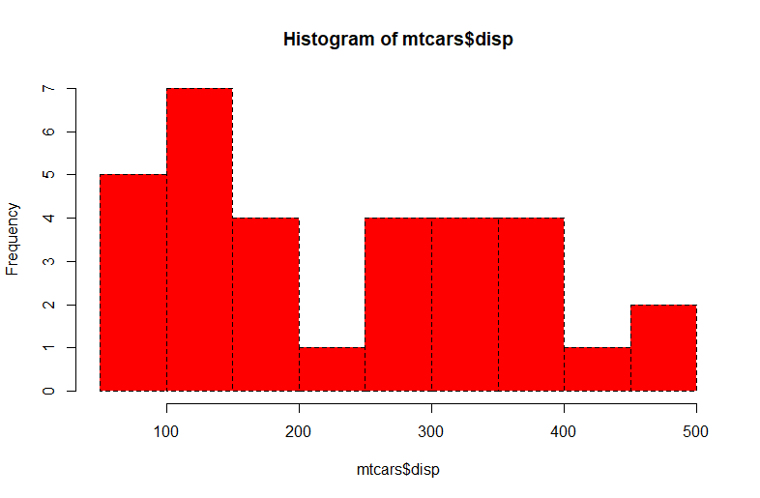
Arguments to hist()
Using col and lty plot a histogram of mtcars$disp with red bars and dotted lines,

Slide 25
Barplots
We will make a simple barplot of the counts of the number of cars with different numbers of gears:
counts <- table(mtcars$gear) barplot(counts, main="Car Distribution", xlab="Number of Gears")

Slide 26
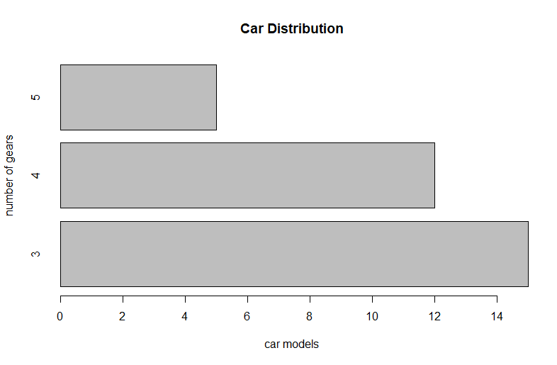
Barplots
We can change this to a horizontal bar plot using the argument horiz=TRUE, add this to your bar plot, remember to change the x axis label as we are switching the axes.

Slide 27
Stacked barplots
Calculate counts by gears and vs using table() as before, separate the two columns of interest with a comma.
We can then plot a stacked barplot of gears coloured by vs
barplot(counts, main="Car Distribution", xlab="Number of Gears", col=c("darkblue","red"), legend = rownames(counts))
Change this stacked barplot to a grouped barplot using the argument beside=TRUE

Slide 28
Boxplots
Boxplots are used to show a central estimate and range of data, in R a standard boxplot shows the median and IQR of the data with whiskers extending 1.5x IQR further out
Plot a boxplot of mpg against cyl:
This also introduces a different syntax you can use for plotting by specifying your data using the data argument and using ~ to show which data columns you want to plot against eachother
boxplot(mpg ~ cyl, data = mtcars,
xlab = "Number of Cylinders",
ylab = "Miles Per Gallon",
main = "Mileage Data")

Slide 29
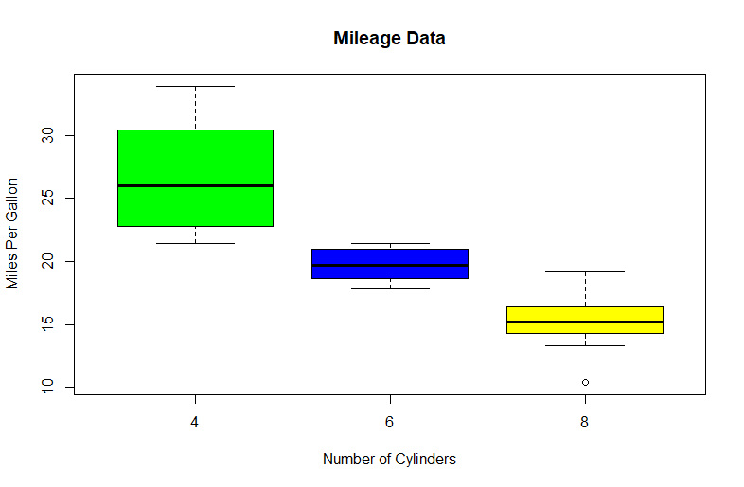
Boxplots
Change the colour of you boxplots using col to set them to green, blue and yellow (Hint: you can use c() with col)

Slide 30
Multiple plots together
We can adjust the plotting area in R using the par() function.
par(mfrow=c(2,3) gives a plot area for 6 plots arranged in 2 rows and 3 columns.
Write your own code to plot 2 of the plots you have made previously side by side (2 columns). You need to run par before you start plotting.

Slide 31
Saving plots to file
In Rstudio you can save plots that are shown in the plot window to file by clicking export and selecting a file type.
You can also save plots directly in R to be more accurate with the final size and resolution. R supports PNG, JPG, SVG and PDF plotting directly from the console

Slide 32
Saving plots to file
To save to file you will need to give a file name within the png function:
png(“plot.png”)
Followed by your plot:
And then:
dev.off()
boxplot(mpg ~ cyl, data = mtcars,
xlab = "Number of Cylinders",
ylab = "Miles Per Gallon",
main = "Mileage Data")

Slide 33
Saving plots to file
Within this function you can specify the size and resolution of your plot with width, height and res. The default width and height are in pixels. This can be changed with the units argument to “in” (inches) “cm” centimetres or “mm” millimetres.

Slide 34
Plotting some polio data
The built in plot functions in R are good for quickly visualising data.
We will load in the non-polio AFP data from 2015 to mid 2019 and use this to demonstrate some plotting

Slide 35
Importing the data
library(dplyr)
library(dataPakistan)
data_name <- system.file(package = "dataPakistan", "extdata") %>% dir(full.names = TRUE) %>% .[5]
NPAFP <- readxl::read_excel(data_name, sheet = 1) %>% as.data.frame()
YOU WILL GET WARNINGS, THESE ARE OK TO IGNORE!

Slide 36
OR
Use the built in Rstudio file browser to select the file if you have saved the data from the memory stick
It is in data/ExcelData

Slide 37
The table() function
Table will calculate the number of times each character string or number occurs in a column of data or simple vector.
Try: table(c(2012,2012,2013,2014))
You will receive a table with the counts of each of these years.
We will now apply this to the years column in the NPAFP dataset
table(NPAFP$YRONSET)

Slide 38
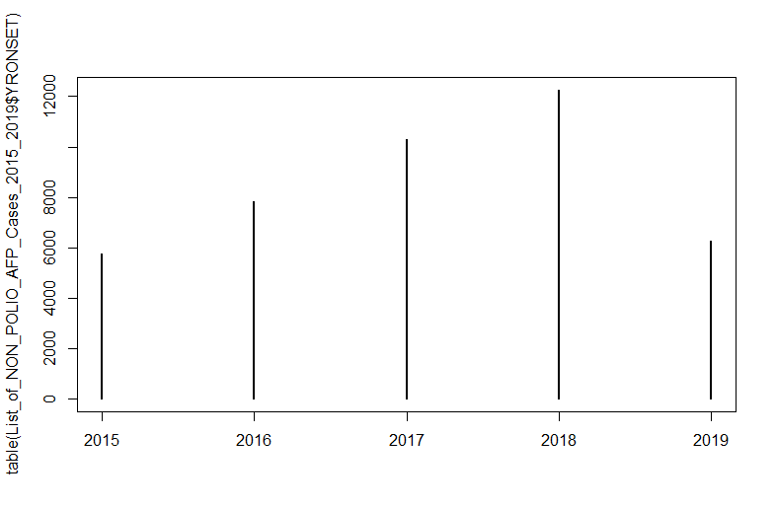
Save this table to an object NPAFP_YR using <- or =
If we plot this object using plot() we will get the following output:

Slide 39
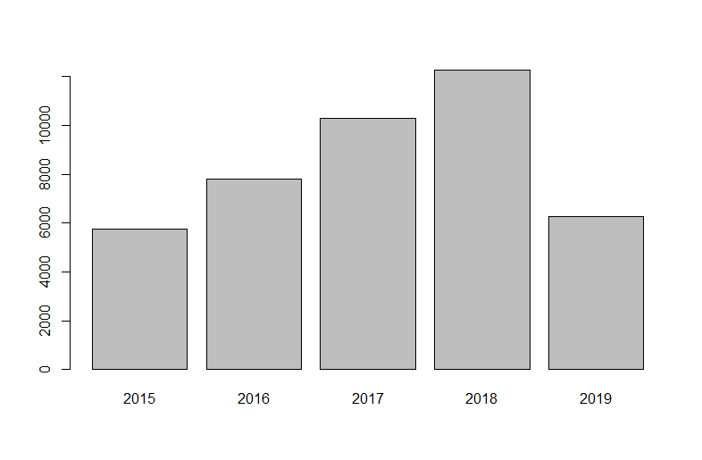
This is a simple barplot created using the plot() function. To make this look nicer we can change plot() for barplot()

Slide 40
Add x and y axis labels to your plot using xlab= and ylab= as we saw earlier.

Slide 41
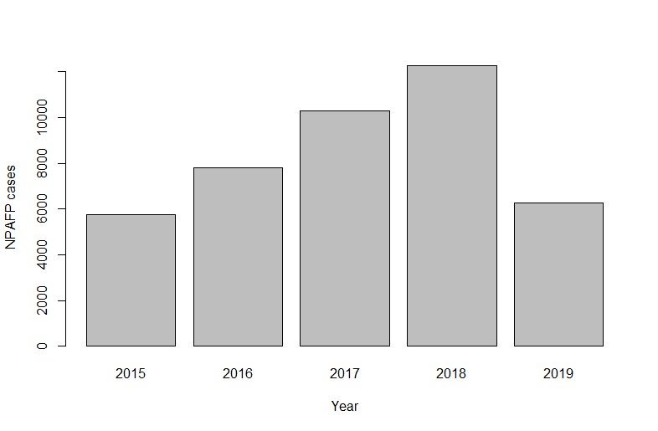
barplot(NPAFP_YR, xlab=“Year”, ylab=“NPAFP cases”)

Slide 42
Subsetting data to plot
Making subsets of your data in R is straightforward, remember referencing inside data frames:
data[row,column]
And using == to determine if something is equal

Slide 43
Subsetting data to plot
Looking at your data file with View() you will see that there is a PROVINCE column in this data. To return all of the unique values in this column we can use the function unique():
unique(NPAFP$PROVINCE)
This returns all of the province names included in this dataset.
This is useful as the dataset is long and scrolling through to see which provinces are included would be laborious.

Slide 44
Subsetting data to plot
If we want to select data from only one of these provinces, for example AJK, we can use the name of the province and run the following command. We will save this to a new object NPAFP_AJK:
NPAFP_AJK<-NPAFP[NPAFP$PROVINCE==“AJK”,]
Try extracting a different province from the dataset, use one of the names given by unique(NPAFP$PROVINCE)
Still need this comma, leaving the space after the comma blank will keep all columns
All rows where the column province is equal to AJK

Slide 45
Plotting a barchart for AJK
Use the table() function to create year totals for AJK in the same way as for the full dataset.
Now make the barplot for AJK by modifying your code from plotting the full dataset.

